Slide 1

Python Tuples
AP G1-Computer Class-3
John Huang

Slide 2

单击此处添加文档标题
Review
Text Type: str
Numeric Types: int, float
Sequence Types: list, tuple
Boolean Type: bool
汇报人：WPS

Slide 3
单击此处添加文档标题
Tuple:
Tuples are used to store multiple items in a single variable.
Tuple is one of 4 built-in data types in Python used to store collections of data, the other 3 are List, Set, and Dictionary, all with different qualities and usage.
A tuple is a collection which is ordered and unchangeable.
Tuples are written with round brackets.
汇报人：WPS

Slide 4

单击此处添加文档标题
Exercise
Create a Tuple:
汇报人：WPS

Slide 5
单击此处添加文档标题
Features of Tuples:
Indexed
Unchangeable
Ordered
Allow Duplicates
汇报人：WPS

Slide 6
单击此处添加文档标题
Features of Tuples:
Tuple Length
To determine how many items a tuple has, use the len() function:
thistuple = ("apple", "banana", "cherry")
汇报人：WPS

Slide 7
单击此处添加文档标题
Question1:
How to Create a Tuple With One Item?
汇报人：WPS

Slide 8
单击此处添加文档标题
Question2:
What kinds of datatype can I store in tuple?
汇报人：WPS

Slide 9
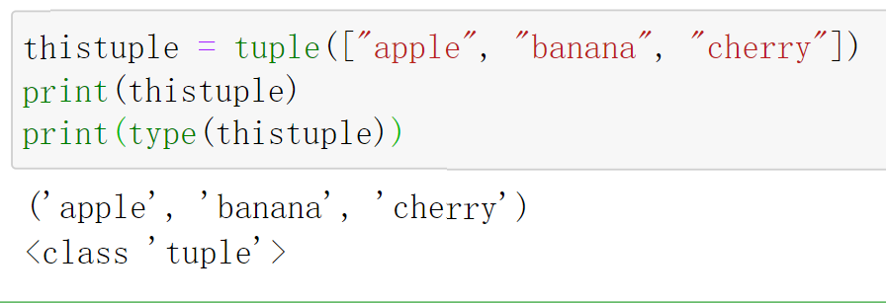
单击此处添加文档标题
The tuple() Constructor Function
It is also possible to use the tuple() constructor to make a tuple.
汇报人：WPS

Slide 10
单击此处添加文档标题
Comparison between different Python Collections (Arrays)
There are four collection data types in the Python programming language:
List is a collection which is ordered and changeable. Allows duplicate members.
Tuple is a collection which is ordered and unchangeable. Allows duplicate members.
Set is a collection which is unordered, unchangeable, and unindexed. No duplicate members.
Dictionary is a collection which is ordered and changeable. No duplicate members.
汇报人：WPS

Slide 11
单击此处添加文档标题
Access Tuple Items
Quiz:
Example_tuple=("apple","banana","cherry","orange","mango","melon")
How can I access the first item in this tuple?
How can I access the last item in this tuple?
How can I access the second and the third items?
汇报人：WPS

Slide 12
单击此处添加文档标题
Update Tuples
Tuples are unchangeable, meaning that you cannot change, add, or remove items once the tuple is created.
x = ("apple", "banana", "cherry")
y = list(x)
y[1] = "kiwi"
x = tuple(y)
print(x)
汇报人：WPS

Slide 13
单击此处添加文档标题
Add Items to Tuples
Can we use append() method?
thistuple = ("apple", "banana", "cherry")
y = list(thistuple)
y.append("orange")
thistuple = tuple(y)
汇报人：WPS

Slide 14
单击此处添加文档标题
Add tuple to a tuple
tuple1 = ("apple", "banana", "cherry")
tuple2 = ("orange",)
tuple3=tuple1+tuple2
print(tuple3)
汇报人：WPS

Slide 15
单击此处添加文档标题
Unpack Tuples
When we create a tuple, we normally assign values to it. This is called "packing" a tuple:
program:
fruits = ("apple", "banana", "cherry")
(green, yellow, red) = fruits
print(green)
print(yellow)
print(red)
汇报人：WPS
Note: The number of variables must match the number of values in the tuple

Slide 16
单击此处添加文档标题
Exceptions:
Using Asterisk*
If the number of variables is less than the number of values, you can add an * to the variable name and the values will be assigned to the variable as a list
fruits = ("apple", "banana", "cherry", "strawberry", "raspberry")
(green, yellow, *red) = fruits
print(green)
print(yellow)
print(red)
汇报人：WPS

Slide 17
单击此处添加文档标题
Loop Tuples:
You can loop through the tuple items by using a for loop.
fruits = ("apple", "banana", "cherry", "strawberry", "raspberry")
Write a for loop to print all the item from the tuple
汇报人：WPS
for x in fruits:
print(x,end=" ")

Slide 18
单击此处添加文档标题
Loop Through the Index Numbers
You can also loop through the tuple items by referring to their index number.
Use the range() and len() functions to create a suitable iterable.
thistuple = ("apple", "banana", "cherry")
for i in range(len(thistuple)):
print(thistuple[i])
汇报人：WPS

Slide 19
单击此处添加文档标题
Using a While Loop
You can loop through the tuple items by using a while loop.
Use the len() function to determine the length of the tuple, then start at 0 and loop your way through the tuple items by referring to their indexes.
Remember to increase the index by 1 after each iteration.
thistuple = ("apple", "banana", "cherry")
i = 0
while i < len(thistuple):
print(thistuple[i])
i = i + 1
汇报人：WPS

Slide 20
单击此处添加文档标题
How to Join Two Tuples?
tuple1 = ("a", "b" , "c")
tuple2 = (1, 2, 3)
tuple3 = tuple1 + tuple2
print(tuple3)
汇报人：WPS

Slide 21
单击此处添加文档标题
Exercise:
Given a tuple containing integers, write a function that returns the sum of the squares of all odd numbers in the tuple.
Requirement:
The input is a tuple which can contain any number of integers.
The return value is an integer that represents the sum of the squares of all the odd numbers in the tuple.
If the tuple is empty or does not contain any odd numbers, then 0 is returned.
Example:
Input: (1, 2, 3, 4, 5)
Output: 35
Explanation: The odd numbers in the tuple are 1, 3, 5 and their sum of squares is 1^2 + 3^2 + 5^2 = 35.
汇报人：WPS

Slide 22
单击此处添加文档标题
def sum_of_odd_squares(numbers):
total = 0
for num in numbers:
if int(num) % 2 != 0:
total += int(num) ** 2
return total
numbers = input("pls input the num ：").split()
result = sum_of_odd_squares(numbers)
print(result)
汇报人：WPS

Slide 23
单击此处添加文档标题
Thank you!
汇报人：WPS

